Slide 1
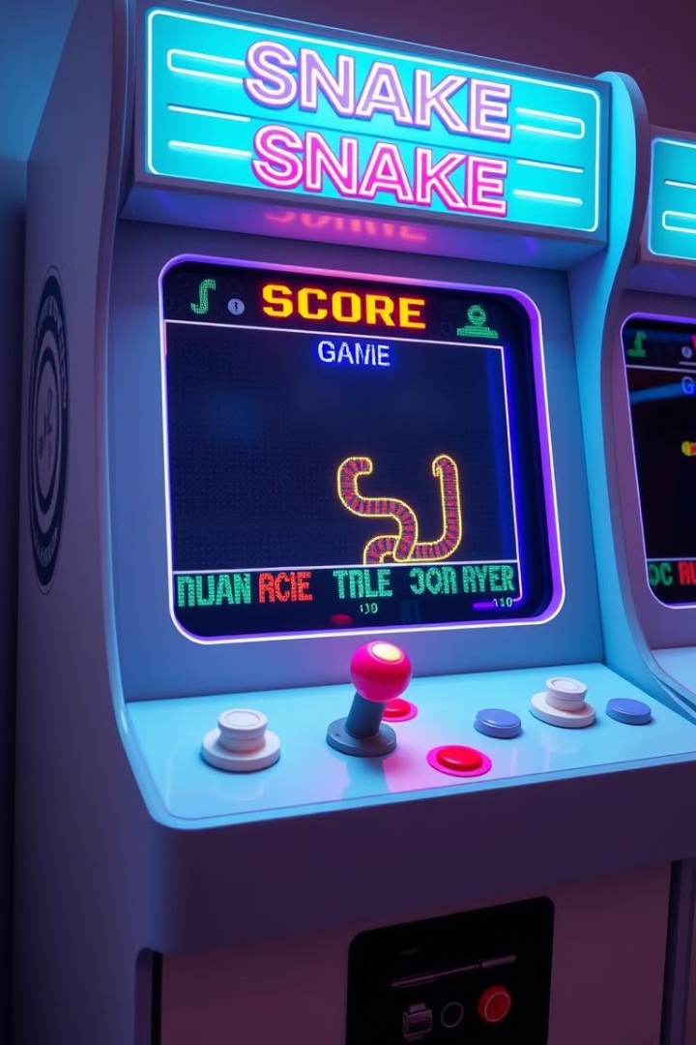
"Welcome to the presentation about the Snake Game developed in Python."
This game is a classic where the player controls a snake that moves around the screen. The goal is to eat food that appears randomly, which causes the snake to grow in length and increase the score. However, the player must avoid hitting the walls or the snake's own body, as this results in losing the game.
In this presentation, we will explain how the game is designed and implemented using Python and the Tkinter library for graphical user interfaces. Additionally, we will discuss how search algorithms can be integrated into the game, potentially to enhance the snake's movement or optimize gameplay mechanics.

Slide 2
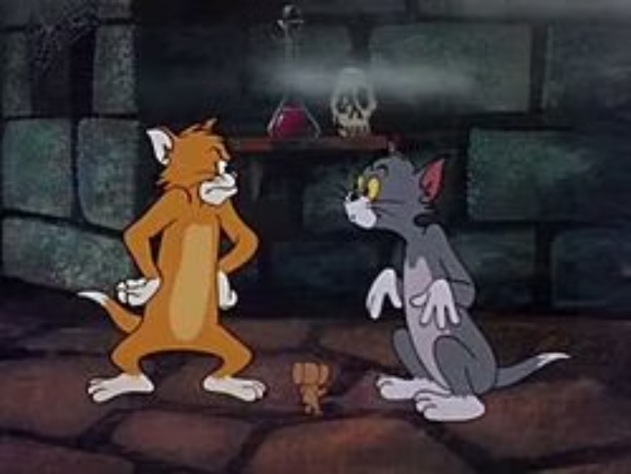
Team Names:
Rafat Ashraf Koliab Abdelmaged ( 2200840)
Alaa Ahmed Ramadan ( 2200917)
Mayada Muhammad Abd El.Qader (2202071)
Shimaa Ramadan Mohamed (2201976)

Slide 3
Understanding the Mechanics of Snake
Objective
Gameplay
The goal of the Snake game is to maneuver a snake through a grid, eating food and growing longer while avoiding collisions with itself or the boundaries of the game area.
The snake is controlled by the player, using directional keys to move the snake's head. Each time the snake eats food, it grows in length, making navigating the game progressively more challenging.

Slide 4

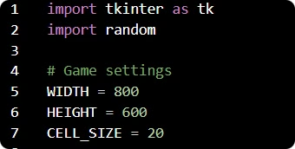
import tkinter as tk: Imports the Tkinter library for creating graphical user interfaces (GUIs).
import random: Imports the random module to generate random positions for food.
Game settings:
WIDTH = 800: Sets the width of the game window.
HEIGHT = 600: Sets the height of the game window.
CELL_SIZE = 20: Defines the size of each grid cell, used to draw both the snake and food.

Slide 5
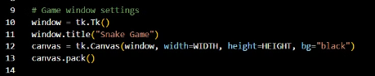
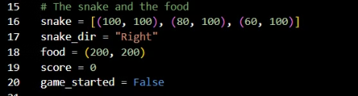
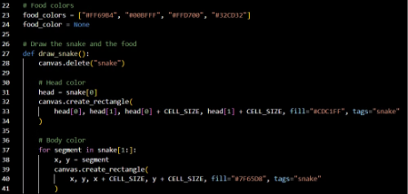
window = tk.Tk(): Initializes a new Tkinter window for the game.
snake: A list of tuples that represent the coordinates of the snake's body. The snake starts with 3 segments.
window.title("Snake Game"): Sets the title of the game window.
draw_snake(): A function to draw the snake on the canvas.
canvas = tk.Canvas(...): Creates a drawing canvas where the game elements (snake, food, score) will be rendered.
snake_dir = "Right": The initial direction of the snake is set to "Right".
canvas.delete("snake"): Clears any existing snake drawing.
food = (200, 200): The initial position of the food.
canvas.pack(): Adds the canvas to the window and displays it.
Head: The first segment of the snake is drawn with a different color (#CDC1FF).
score = 0: The starting score is 0.
game_started = False: A flag to track whether the game has started.
Body: The remaining segments of the snake are drawn with the color #7F65D8.

Slide 6
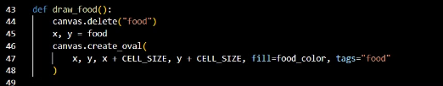
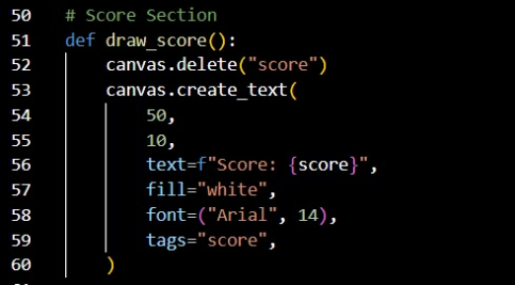
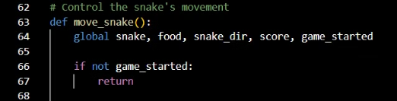
draw_food(): A function to draw the food on the canvas.
move_snake(): A function to move the snake in the direction it is facing.
canvas.create_oval(...): Draws a circular food item with the color set by food_color
if not game_started:: The game will not move if it hasn't started.
draw_score(): A function to draw the score on the canvas.
canvas.create_text(...): Draws the current score at the top left corner of the window.

Slide 7
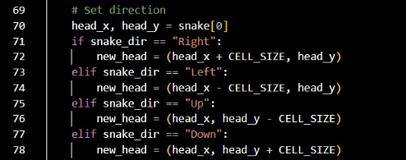
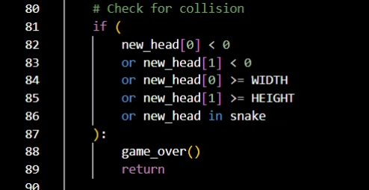
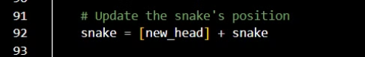
Updating the Snake's Position
This line of code moves the snake forward by adding the new head at the front of the list and shifting the body (the rest of the segments) accordingly. If the snake eats food, this operation
The position of the snake's head is updated based on the direction it's moving. The head_x and head_y represent the current position, and depending on the direction (Right, Left, Up, Down), the new position is calculated by adding or subtracting CELL_SIZE to either the x or y coordinate
Collision with Walls: If the snake hits the edges of the window, the game ends.
will increase the size of the snake, as the body will not "pop" the last segment when it eats.
Collision with Itself: If the snake collides with its own body, the game ends.
This section calculates the new head position based on the current direction of the snake.

Slide 8
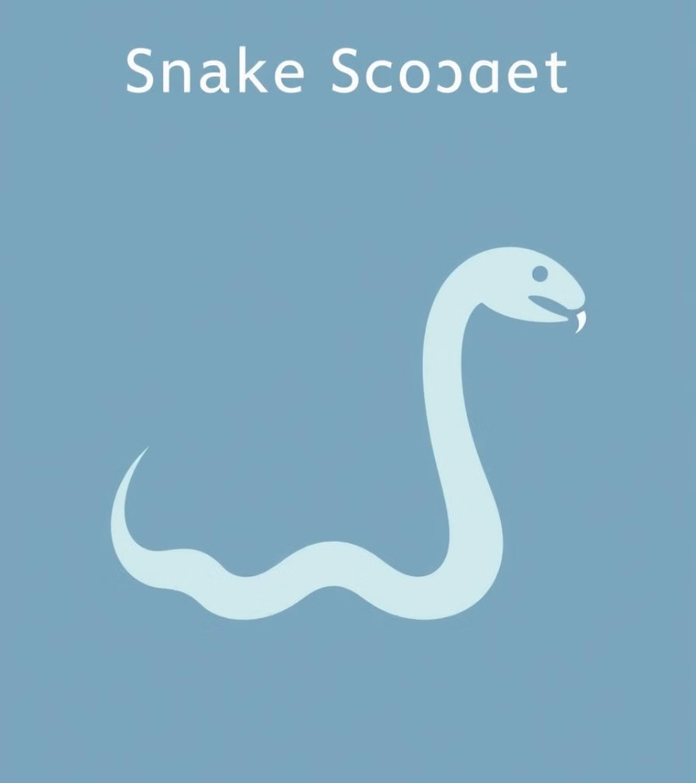



Defining the Snake Object and its Behavior
Snake Class
Define a Snake class to encapsulate the snake's attributes and behavior, including position, direction, and movement logic.
Movement Function
Implement a function within the Snake class to handle snake movement, updating the snake's position based on its direction.
Growth Function
Add a function that allows the snake to grow in length when it consumes food, adding a new segment to its body.

Slide 9
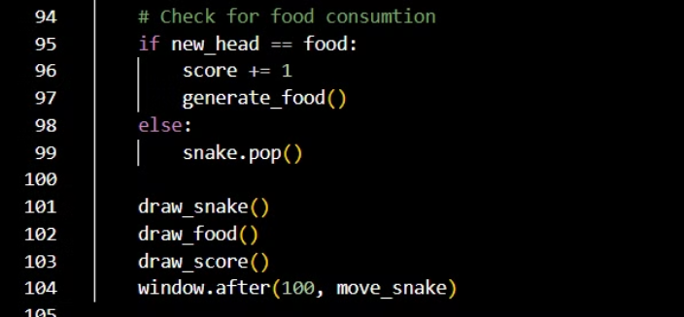
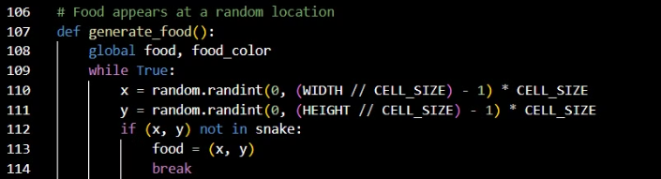
generate_food(): A function to randomly generate new food at a location not occupied by the snake.
WIDTH // CELL_SIZE: Calculates how many cells fit horizontally across the screen.
If the snake's new head position matches the food's position, the snake grows and the score increases.
HEIGHT // CELL_SIZE: Calculates how many cells fit vertically.
If no food is eaten, the snake moves forward, and the last segment is removed to simulate movement.
random.randint(0, (WIDTH // CELL_SIZE) - 1): Picks a random integer between 0 and the number of cells in the width (excluding the last cell).
The random value is then multiplied by CELL_SIZE to get the correct pixel coordinates for the food.
The if statement checks if the randomly generated food coordinates (x, y) are not already occupied by the snake's body.
If the position is free, it assigns the food's coordinates and exits the loop.

Slide 10
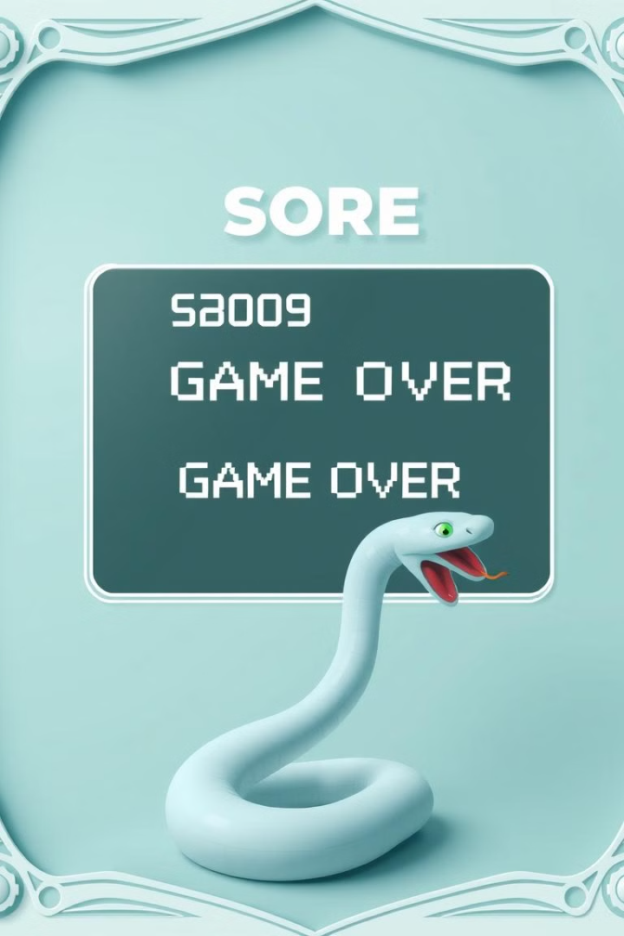
Enhancing the Game with Scoring and Game Over Conditions
1
Score Tracking
Implement a scoring system to keep track of the snake's length and display the score on the screen.
2
Game Over Detection
Define game over conditions, such as the snake colliding with itself or the boundaries.
3
Game Over Screen
Display a game over screen when a game over condition is met, showing the final score and an option to restart the game.

Slide 11

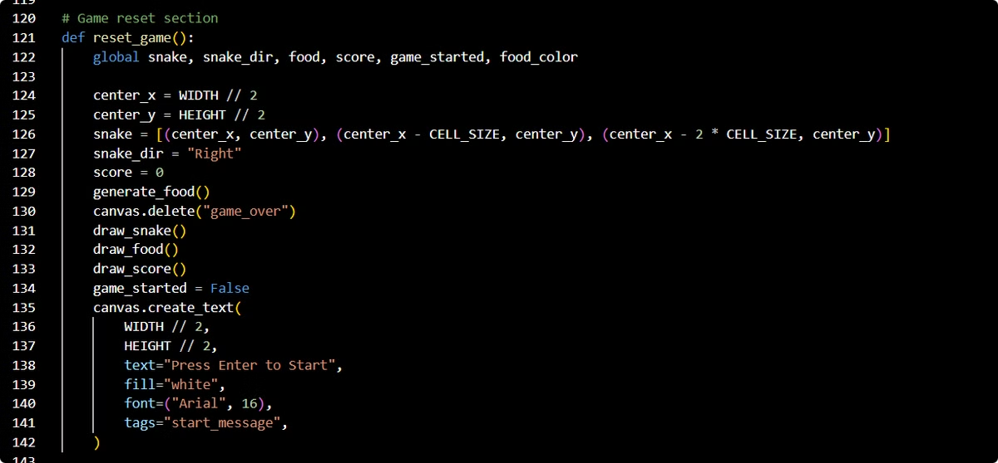
The reset_game() function resets the game to its initial state when the player restarts or when the game ends. Here's a breakdown of what it does:
Initial Snake Position:
The snake starts in the center of the screen. The center_x and center_y variables calculate the center of the canvas, and the snake list is initialized with three segments placed horizontally next to each other to form the initial snake.
Resetting Game Variables:
The snake's movement direction is set to "Right" by default (snake_dir = "Right").
The player's score is reset to 0 (score = 0).
Generate New Food:
The generate_food() function is called to randomly place the food on the screen in a position that isn't already occupied by the snake.
Clear "Game Over" Message:
If there was a "Game Over" message from the previous game, it is deleted from the screen with canvas.delete("game_over").
Redrawing the Snake, Food, and Score:
The game elements are redrawn: the snake (draw_snake()), the food (draw_food()), and the score (draw_score()) are all updated and shown on the screen.
Setting the Game to Not Started:
The game is set to game_started = False, ensuring that the game won't start until the player presses "Enter".
Displaying the Start Message:
A message prompting the player to press "Enter" to start the game is shown in the center of the screen.
In Conclusion:
The reset_game() function effectively prepares the game for a new round by resetting the snake, score, and other variables to their initial states, clearing any game-over messages, and displaying instructions for the player to start the game again.

Slide 12
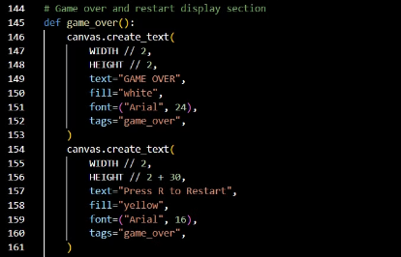
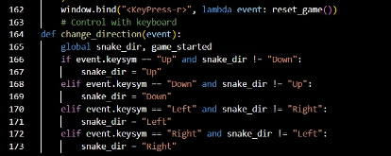
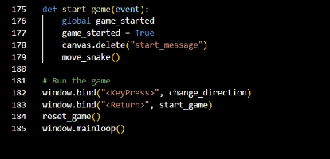
This line binds the "r" key to the reset_game() function, so when the player presses "r" on the keyboard, the game will reset. The lambda function is used to trigger the reset_game() function in response to the key press event.//162.
The start_game() function starts the game when the Enter key is pressed, removes the start message, and begins moving the snake.
game_over(): Displays a "GAME OVER" message on the screen and instructs the player to press "R" to restart the game.
The window.bind() methods link the keyboard events to their respective functions: the Arrow keys to change the snake's direction, and the Enter key to start the game.
WIDTH // 2 and HEIGHT // 2 position the text at the center of the screen.
The change_direction() function updates the snake's movement direction based on the player's keyboard input. It ensures the snake cannot move directly in the opposite direction, preventing self-collisions. It responds to the arrow keys: "Up", "Down", "Left", and "Right".
The text is displayed in white, with the font set to Arial and a size of 24.
The tags="game_over" allows this text to be easily identified and manipulated later (e.g., for deletion)
The game is initialized with reset_game() and then runs in the Tkinter event loop using window.mainloop().
This line displays the text "Press R to Restart" just below the "GAME OVER" message.
The HEIGHT // 2 + 30 ensures that the "Press R to Restart" message is placed slightly below the "GAME OVER" message.
This text is displayed in yellow with the font set to Arial and size 16, prompting the player to press "R" to restart the game.
Like the previous message, this is tagged with tags="game_over" to help with identification and management.

Slide 13
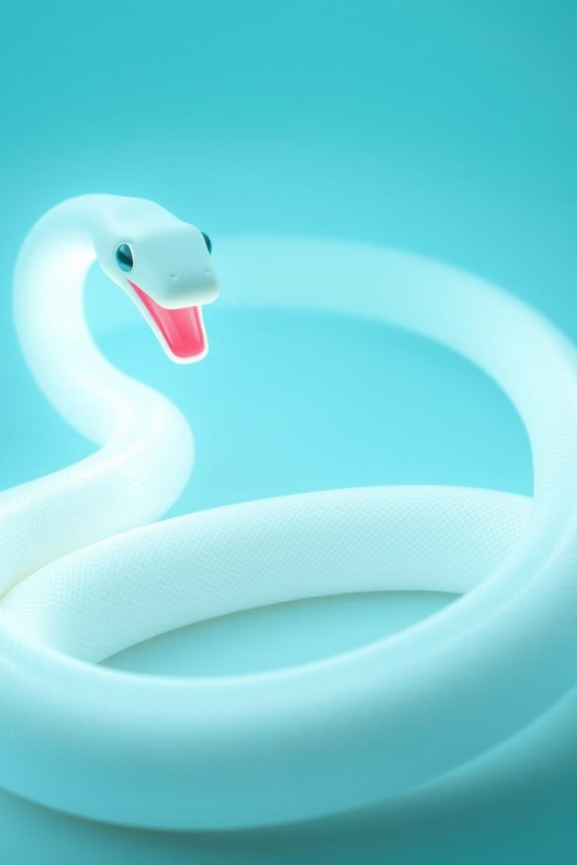
Conclusion and Next Steps for Exploration
Congratulations! You've successfully built a classic Snake game. Next steps include expanding on the game's features and exploring more advanced concepts. Consider adding features like: - Different difficulty levels - Power-ups - Multiple player mode - Sound effects

Slide 14


Thank YOU!!

